Slide 1
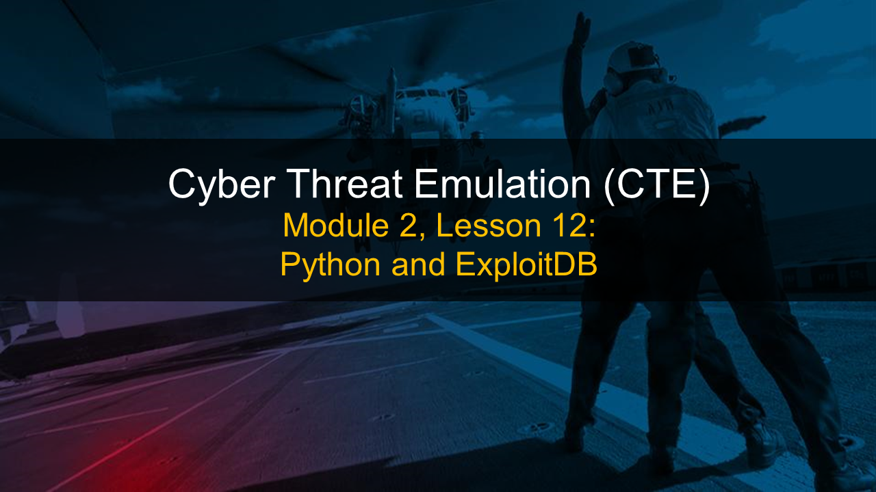

Slide 2
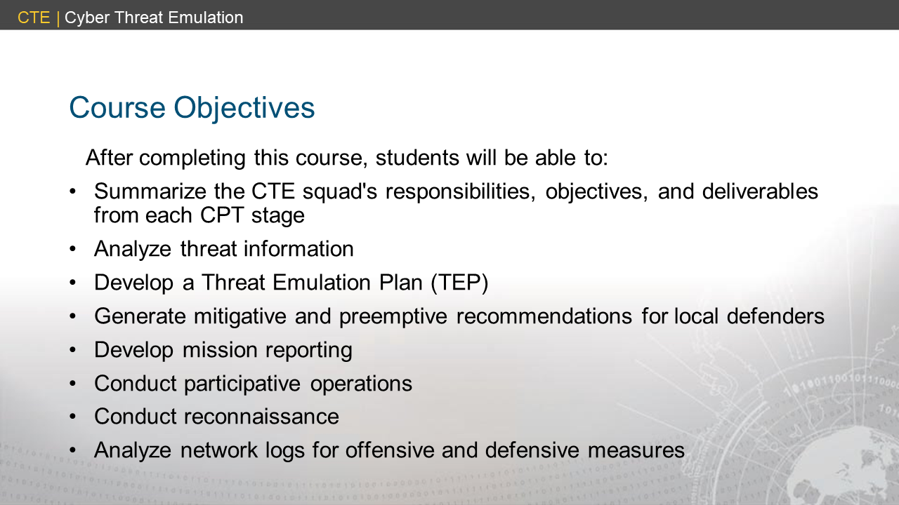

Slide 3
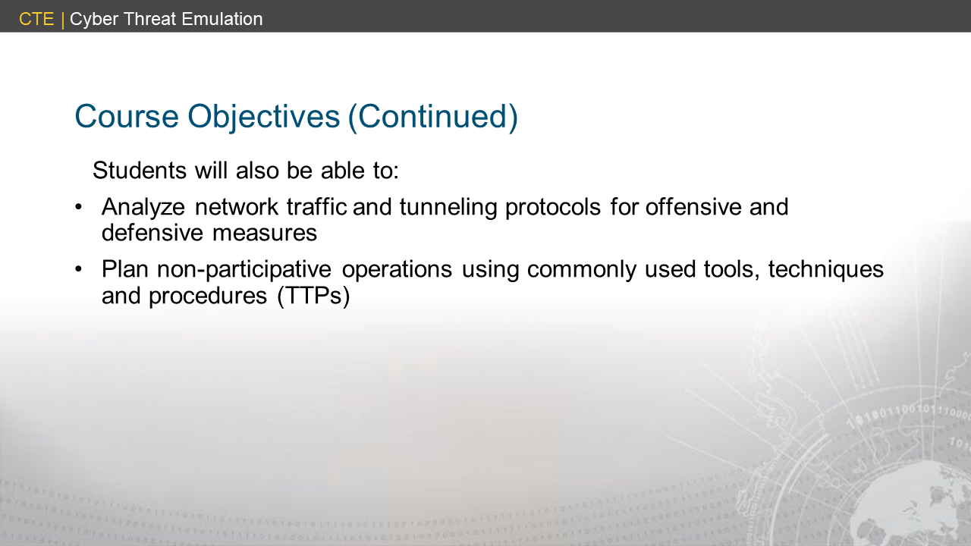

Slide 4
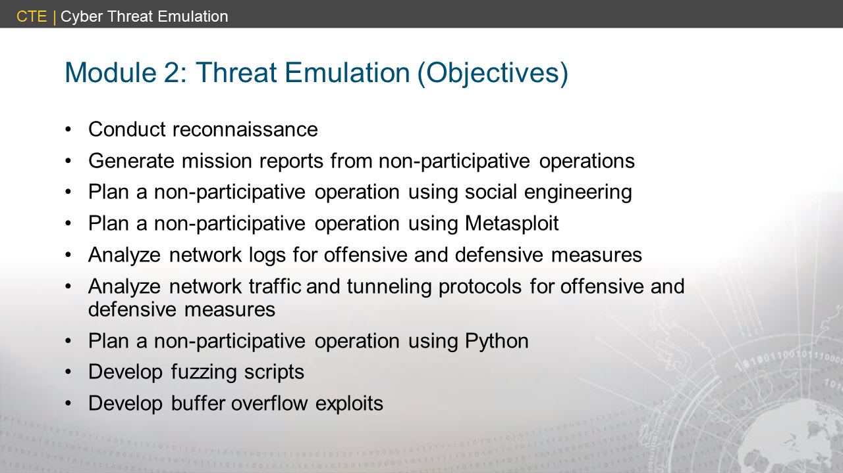

Slide 5
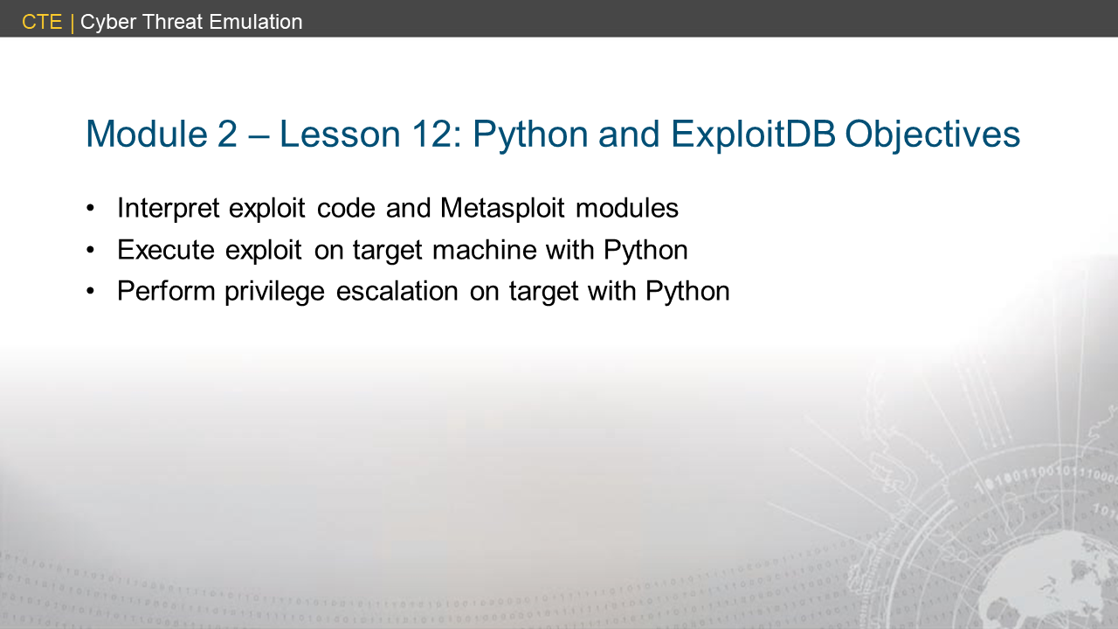

Slide 6
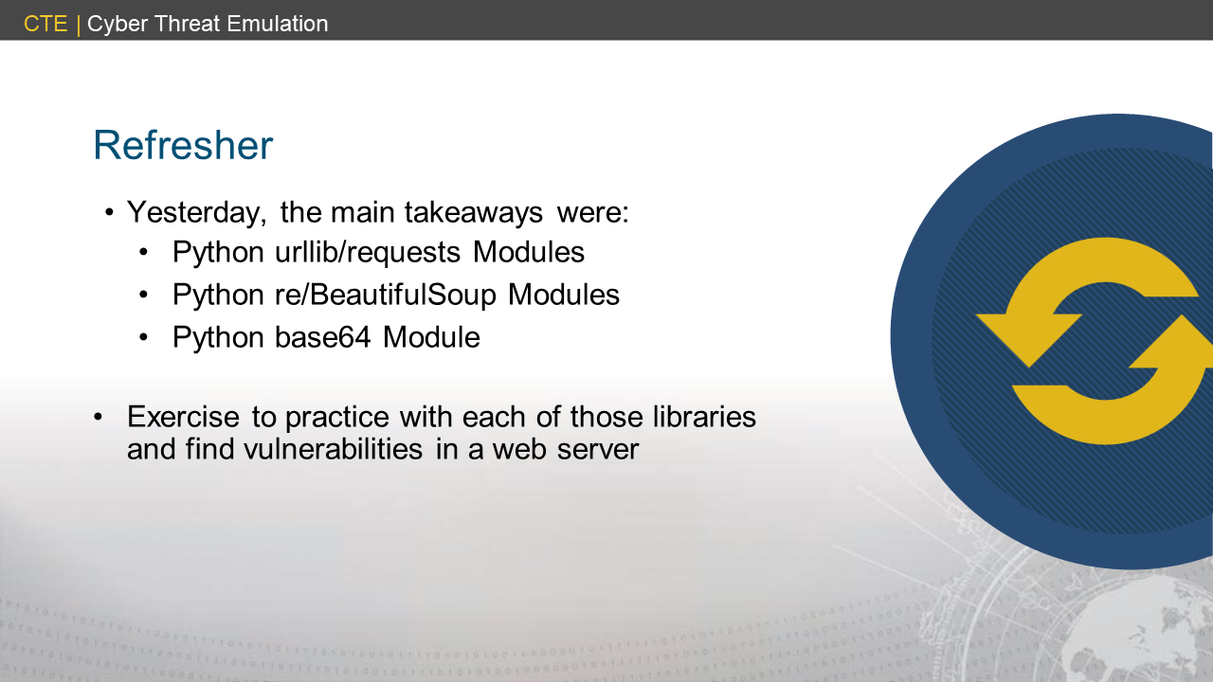

Slide 7
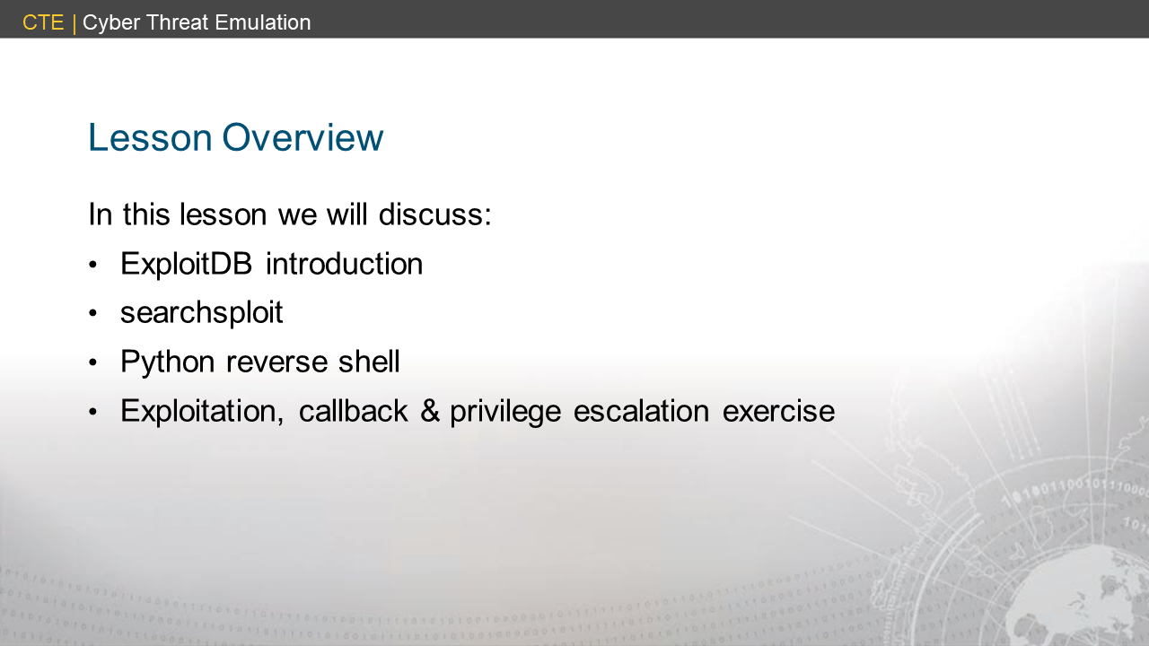

Slide 8
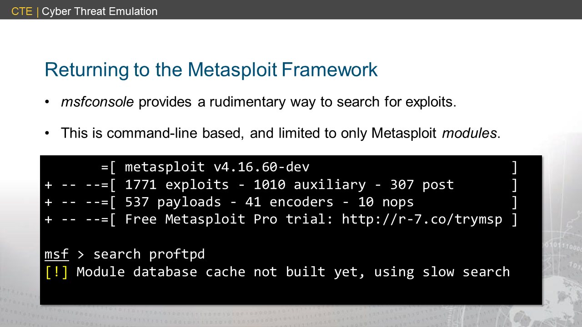
Notes:
<exploitdb1>

Slide 9
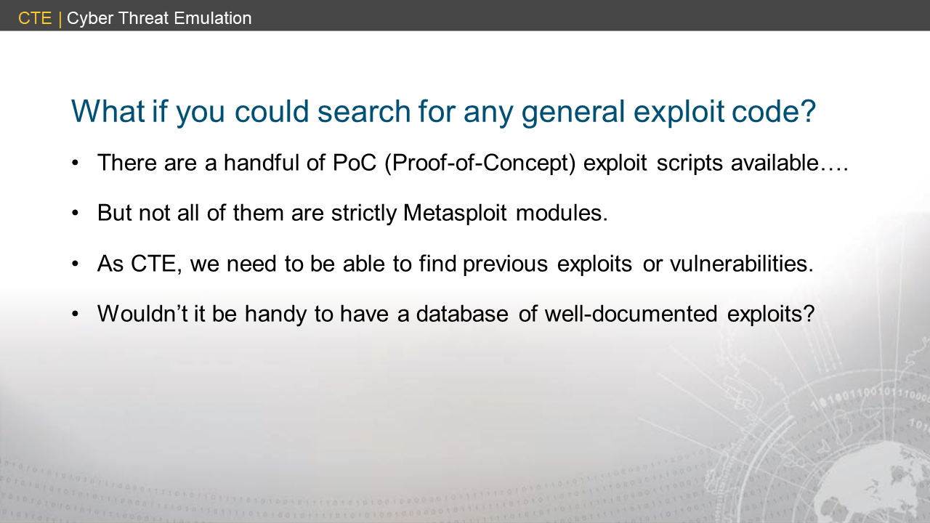

Slide 10
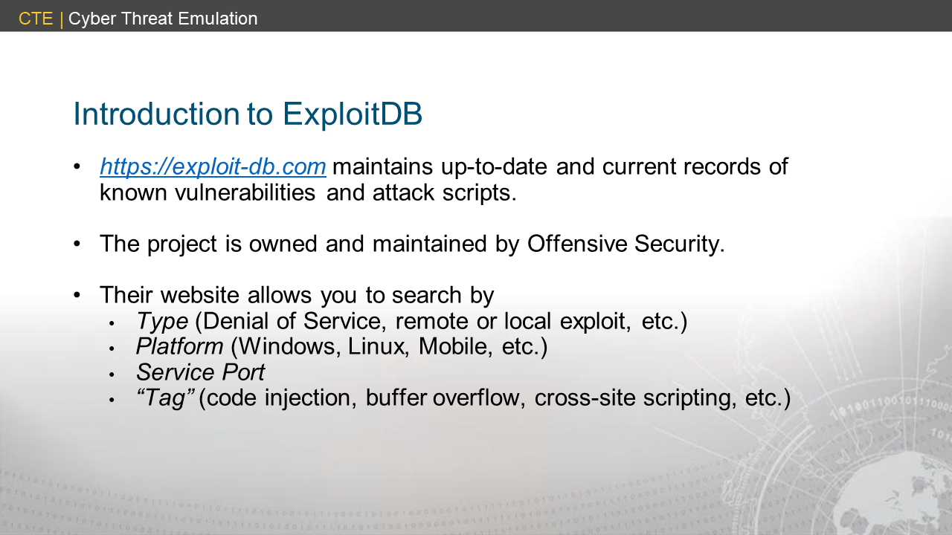

Slide 11
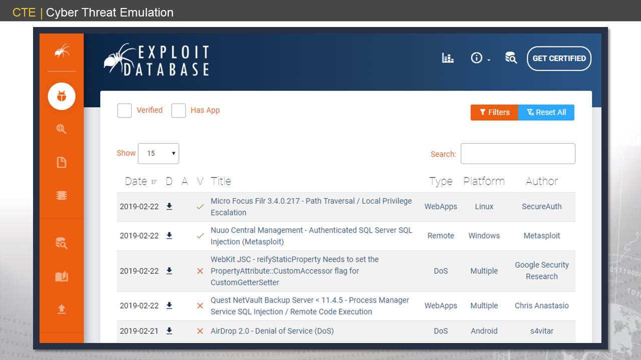
Notes:
<exploitdb2>

Slide 12
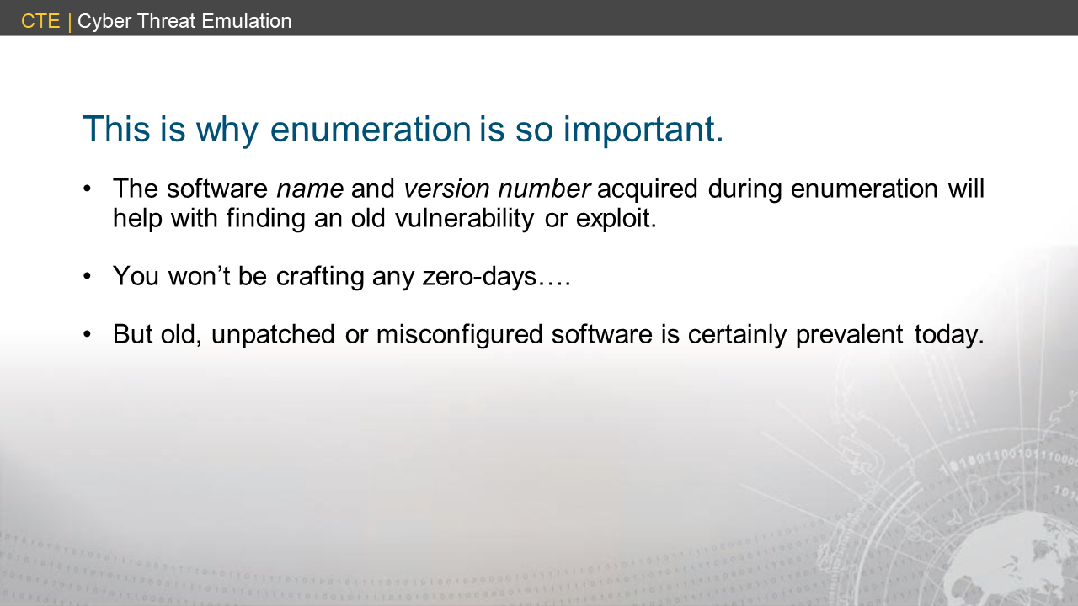

Slide 13
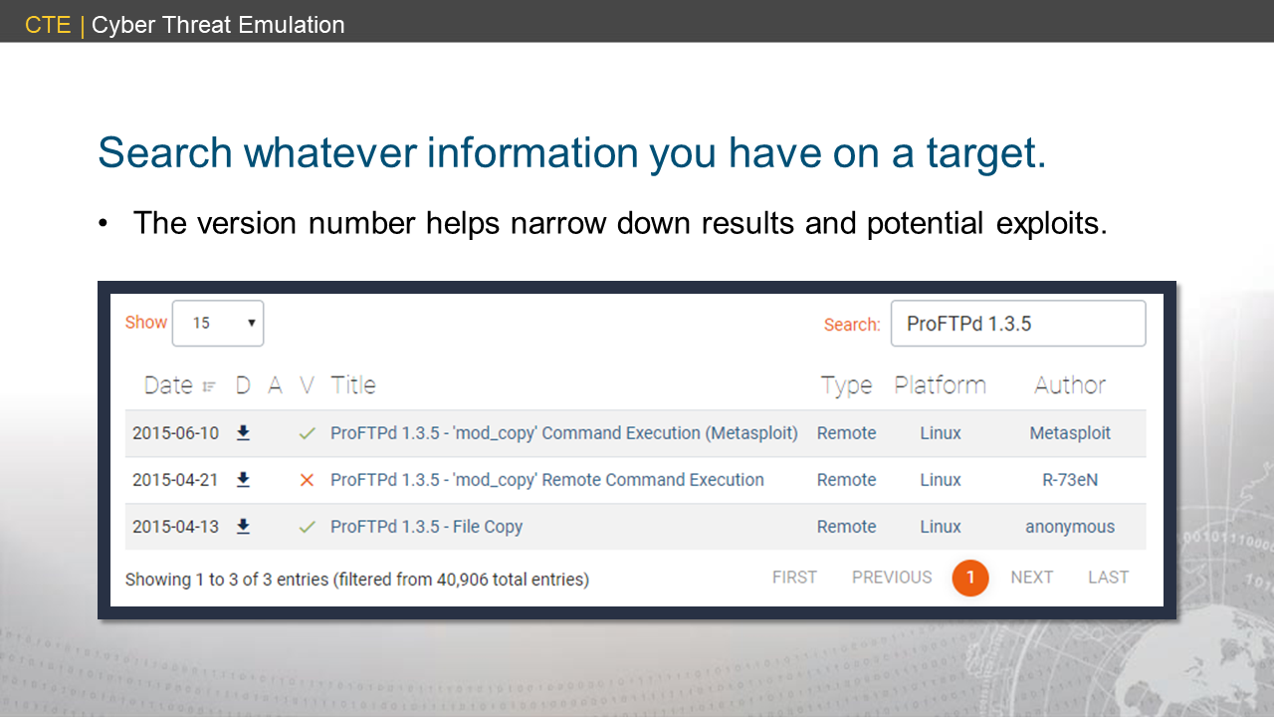
Notes:
<exploitdb3>

Slide 14
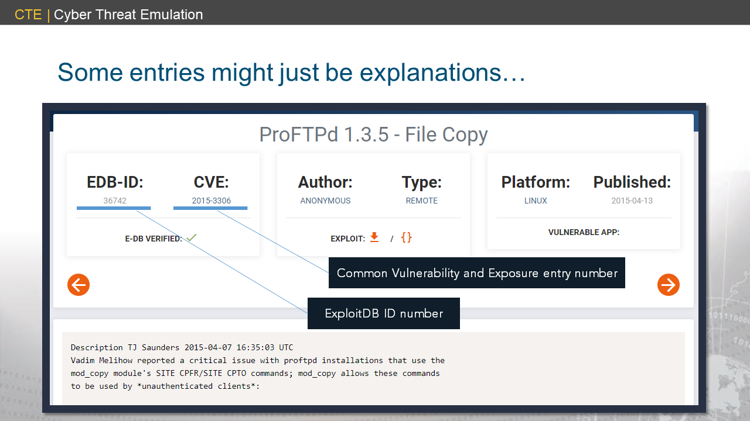
Notes:
<exploitdb4>

Slide 15
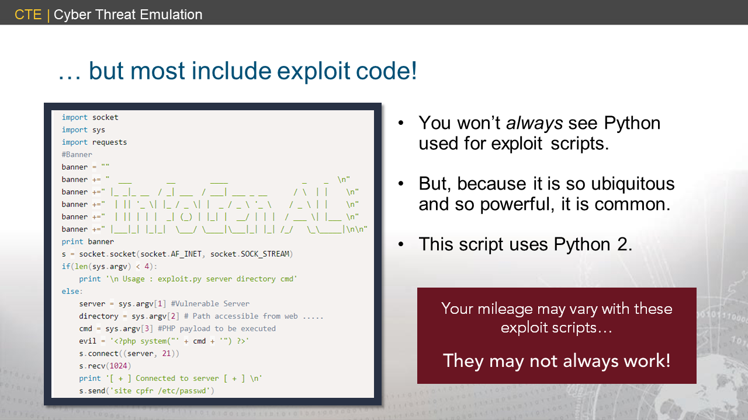
Notes:
<exploitdb5>

Slide 16
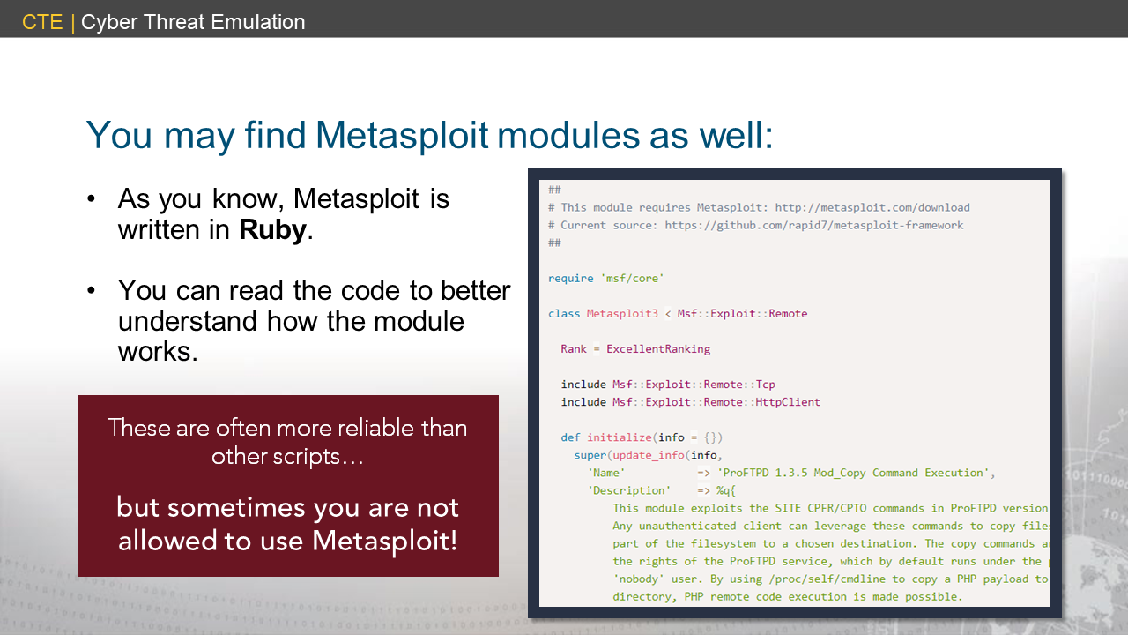
Notes:
<exploitdb6>

Slide 17
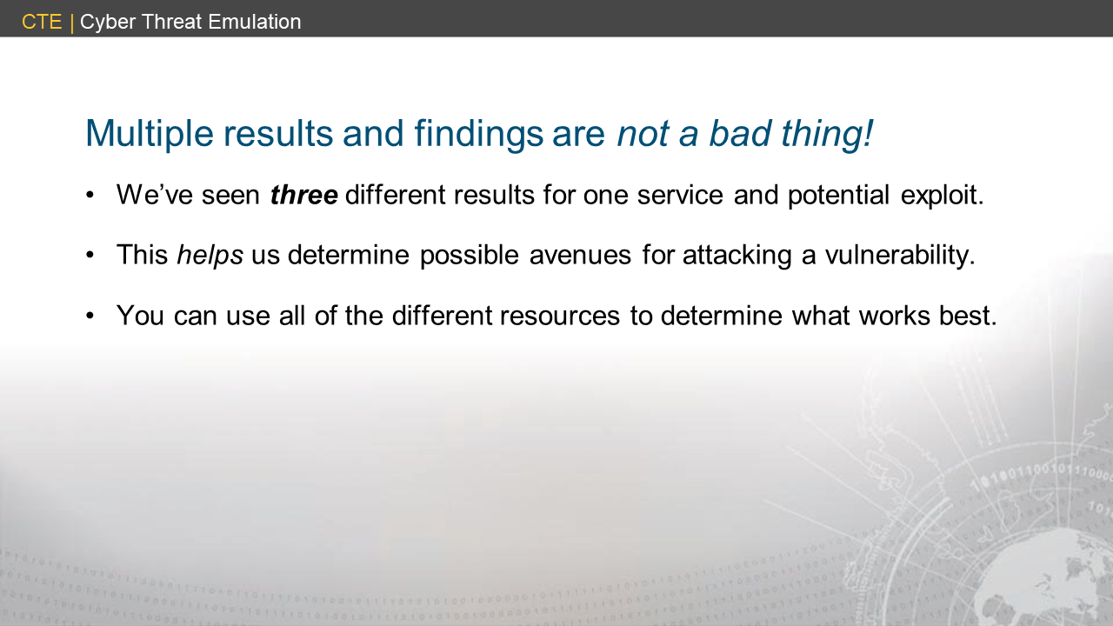

Slide 18
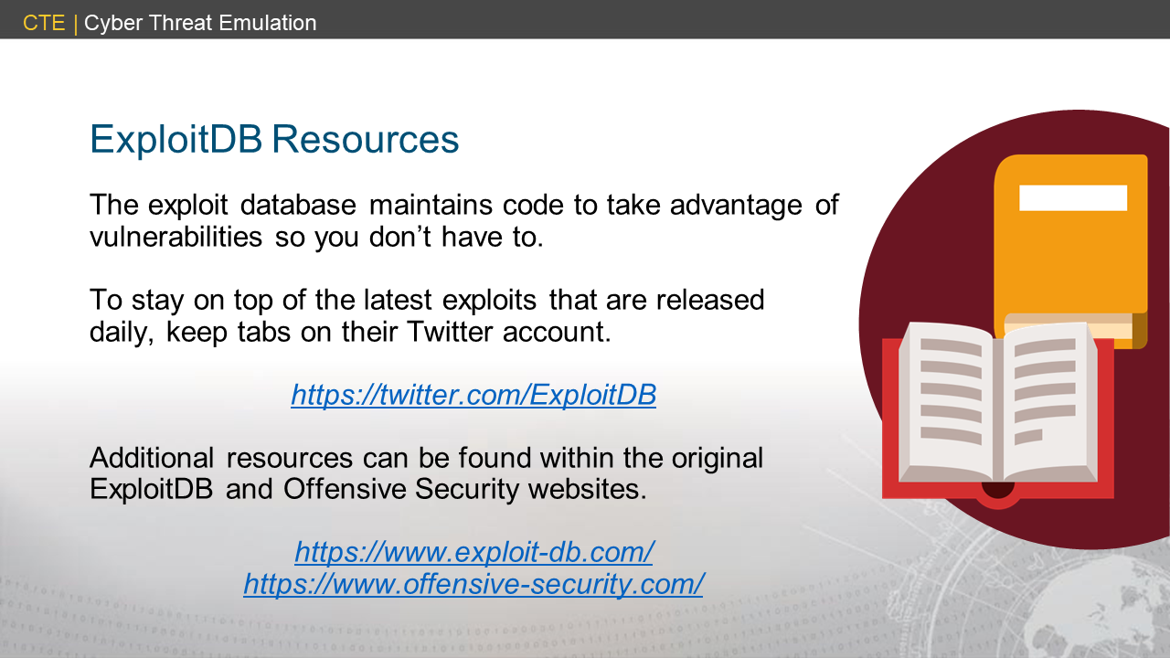

Slide 19
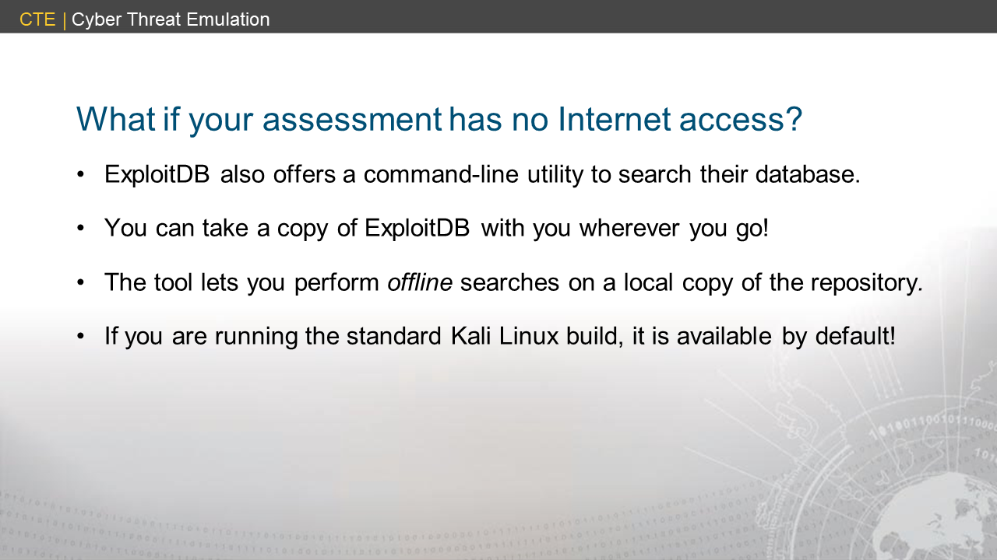

Slide 20
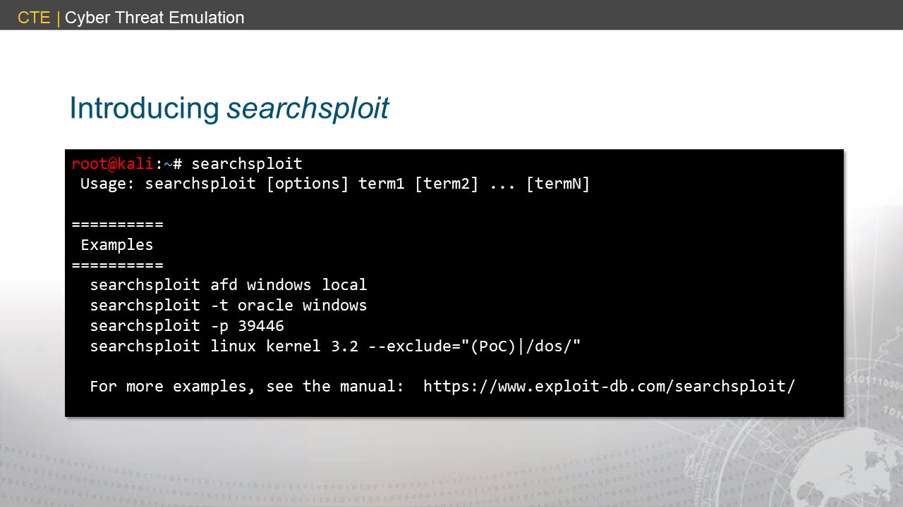
Notes:
<searchsploit1>

Slide 21
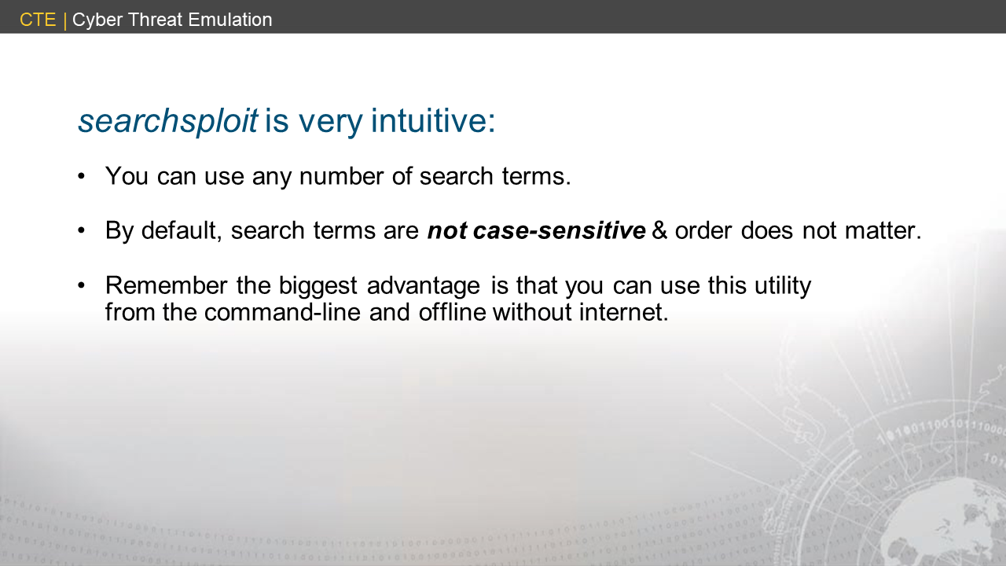

Slide 22
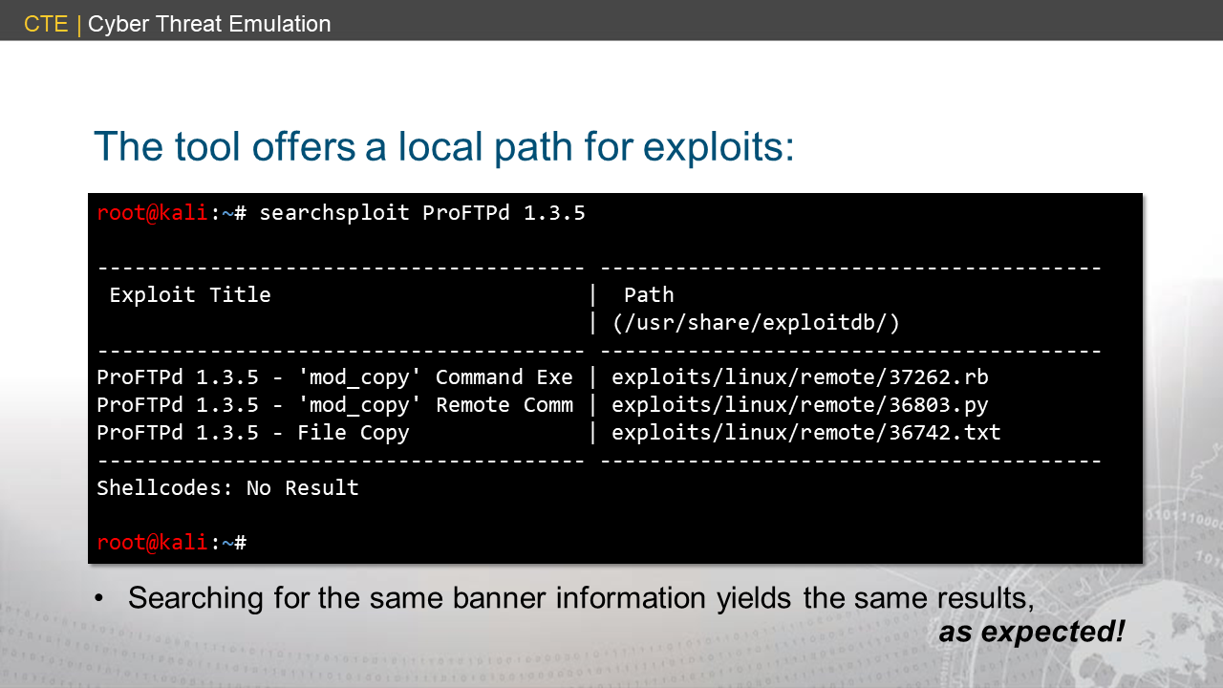
Notes:
<searchsploit2>

Slide 23
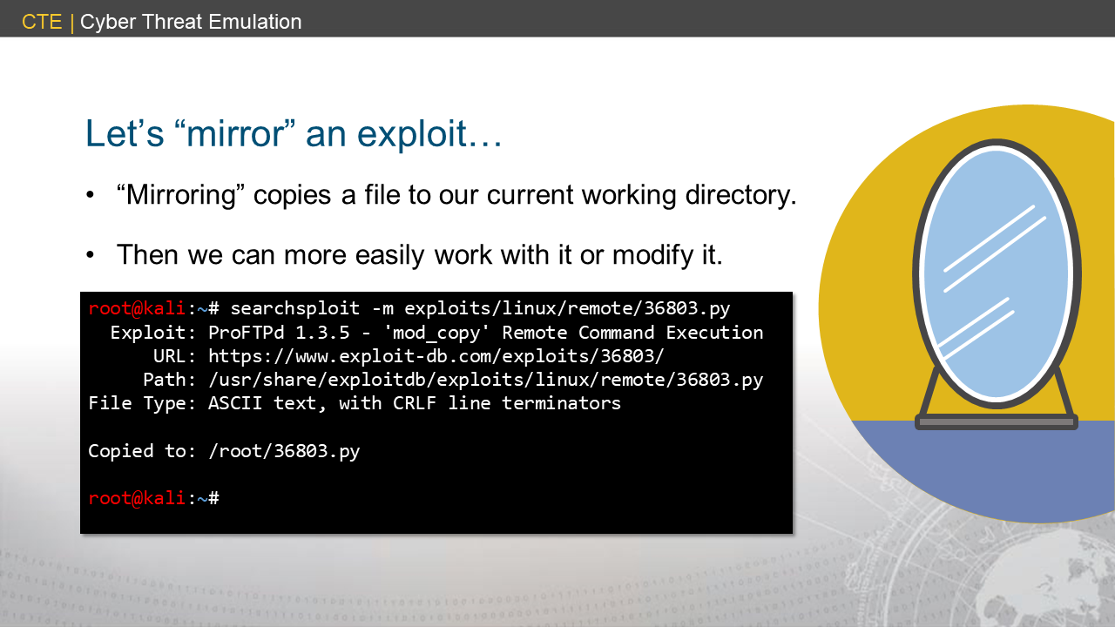
Notes:
<searchsploit2>

Slide 24
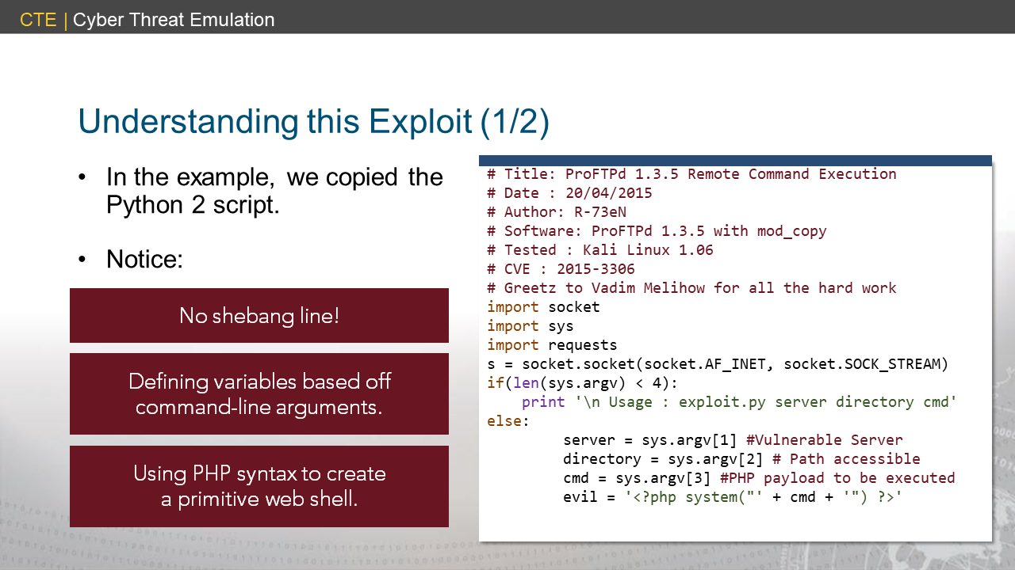
Notes:
<searchsploit3>

Slide 25
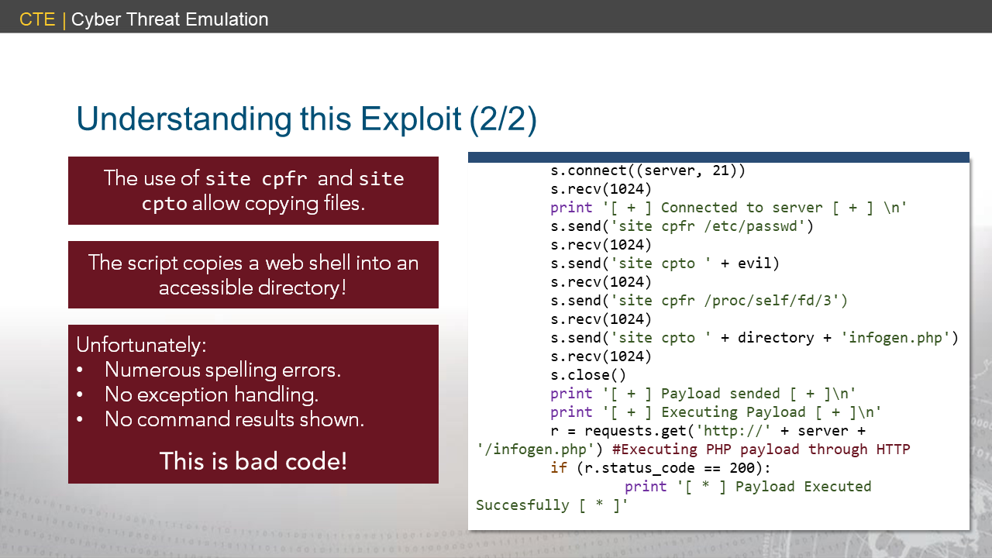
Notes:
<searchsploit4>

Slide 26
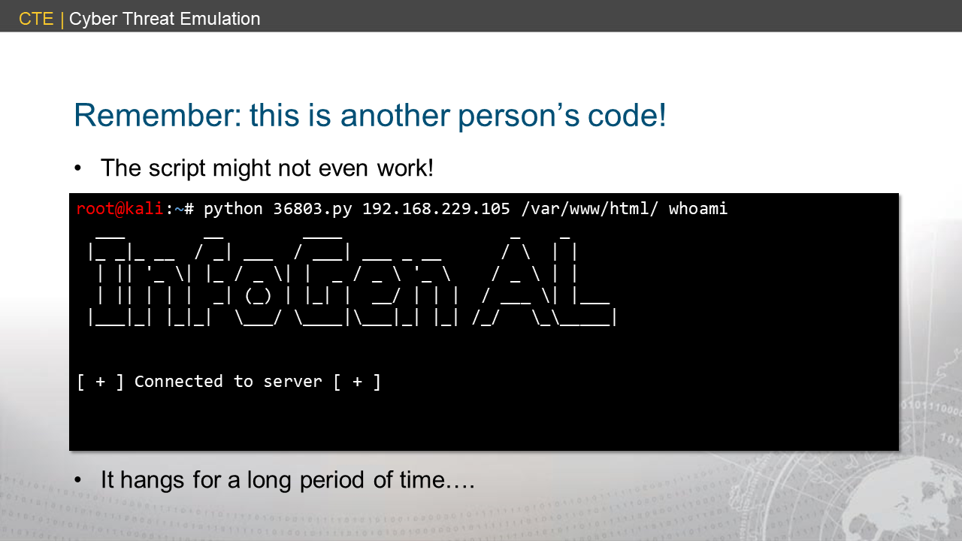
Notes:
<searchsploit5>

Slide 27
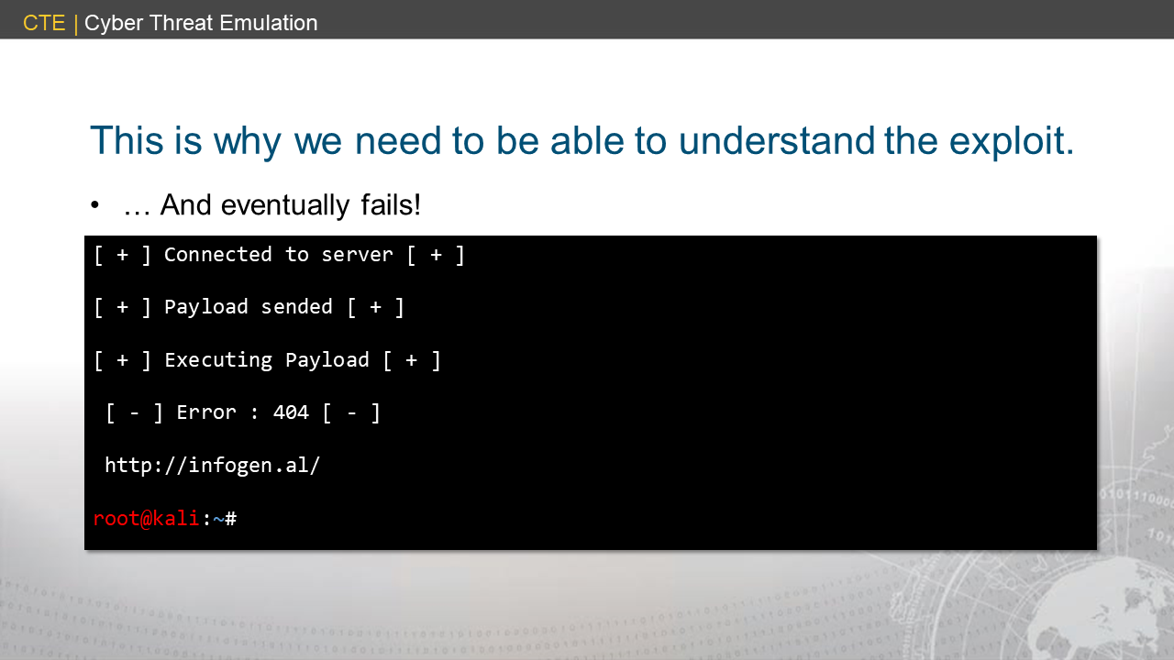
Notes:
<searchsploit6>

Slide 28
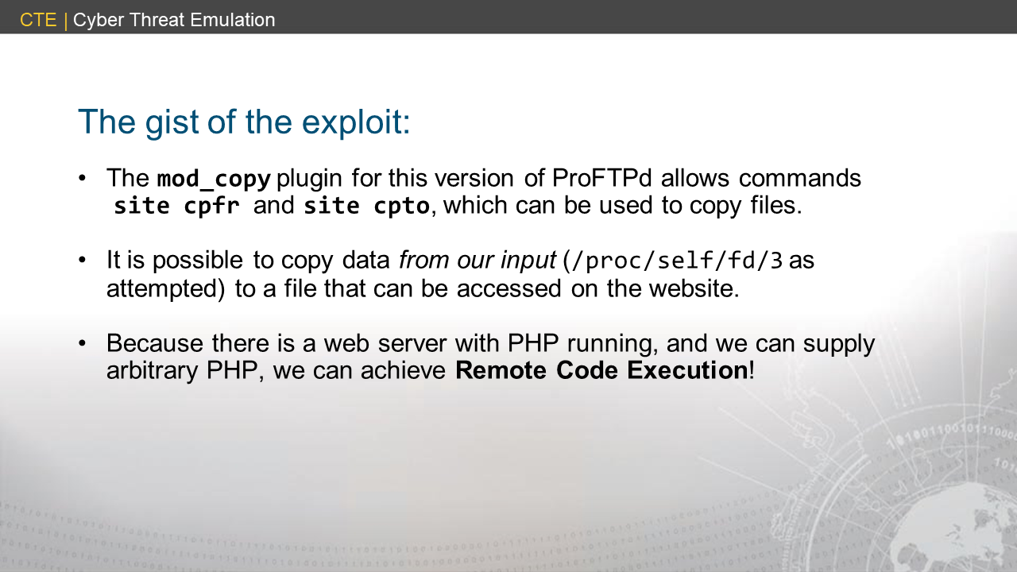

Slide 29
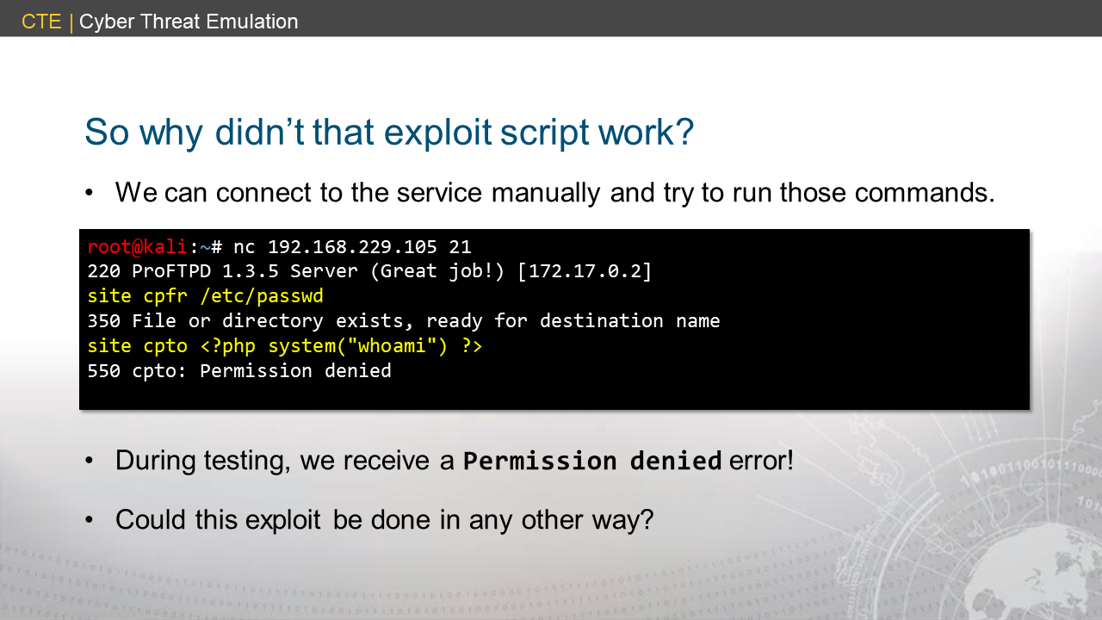
Notes:
searchsploit7

Slide 30
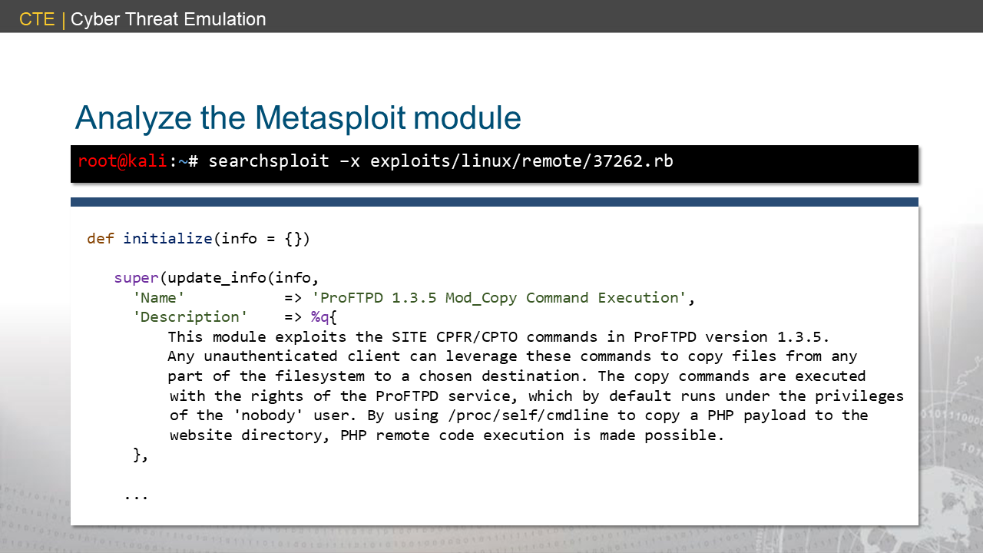
Notes:
searchsploit8

Slide 31
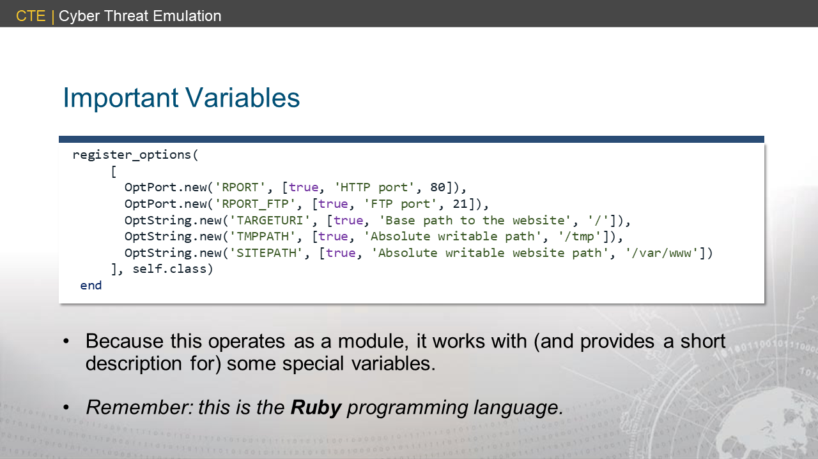
Notes:
searchsploit9

Slide 32
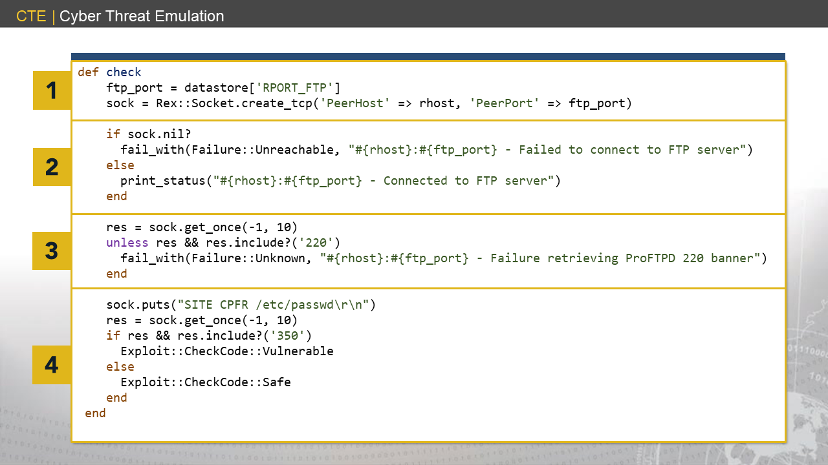
Notes:
<searchsploit10>

Slide 33
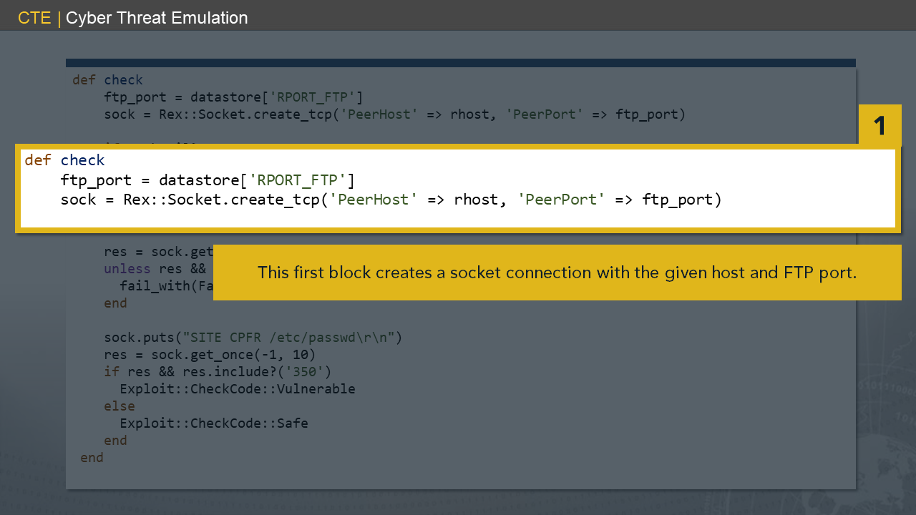
Notes:
searchsploit11a

Slide 34
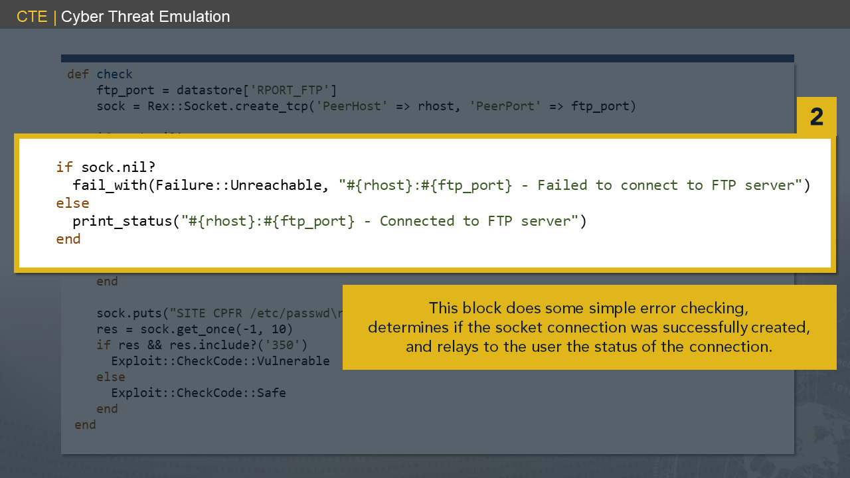
Notes:
searchsploit11

Slide 35
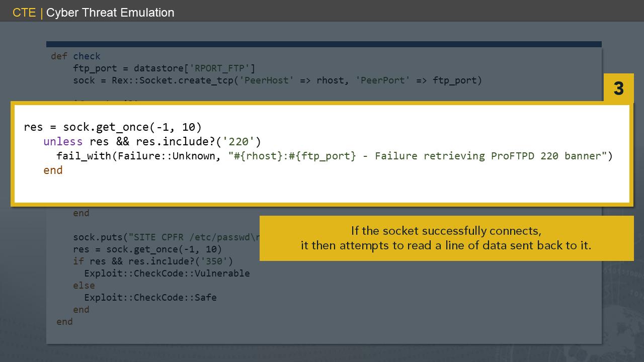
Notes:
searchsploit12

Slide 36
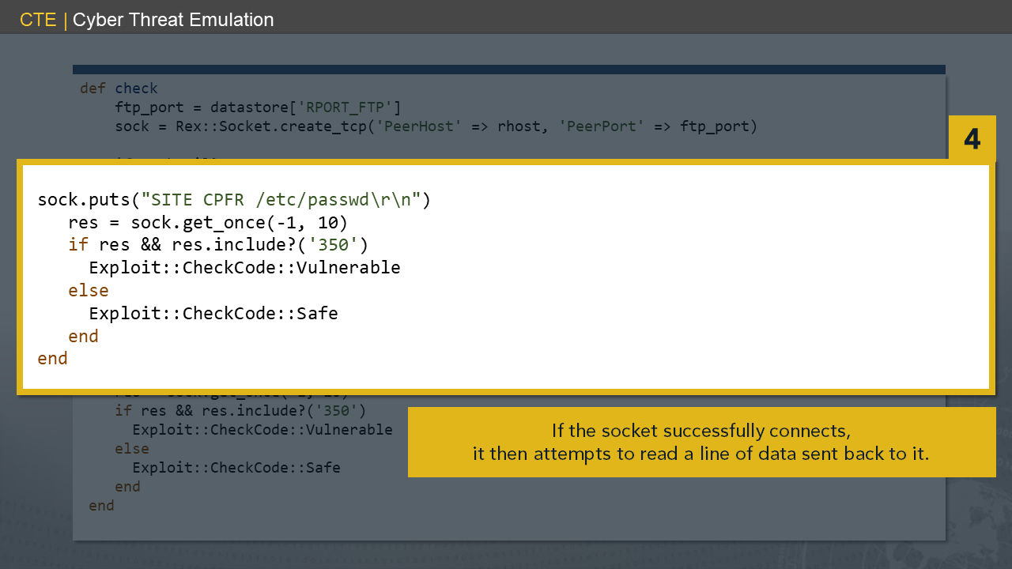
Notes:
searchsploit13

Slide 37
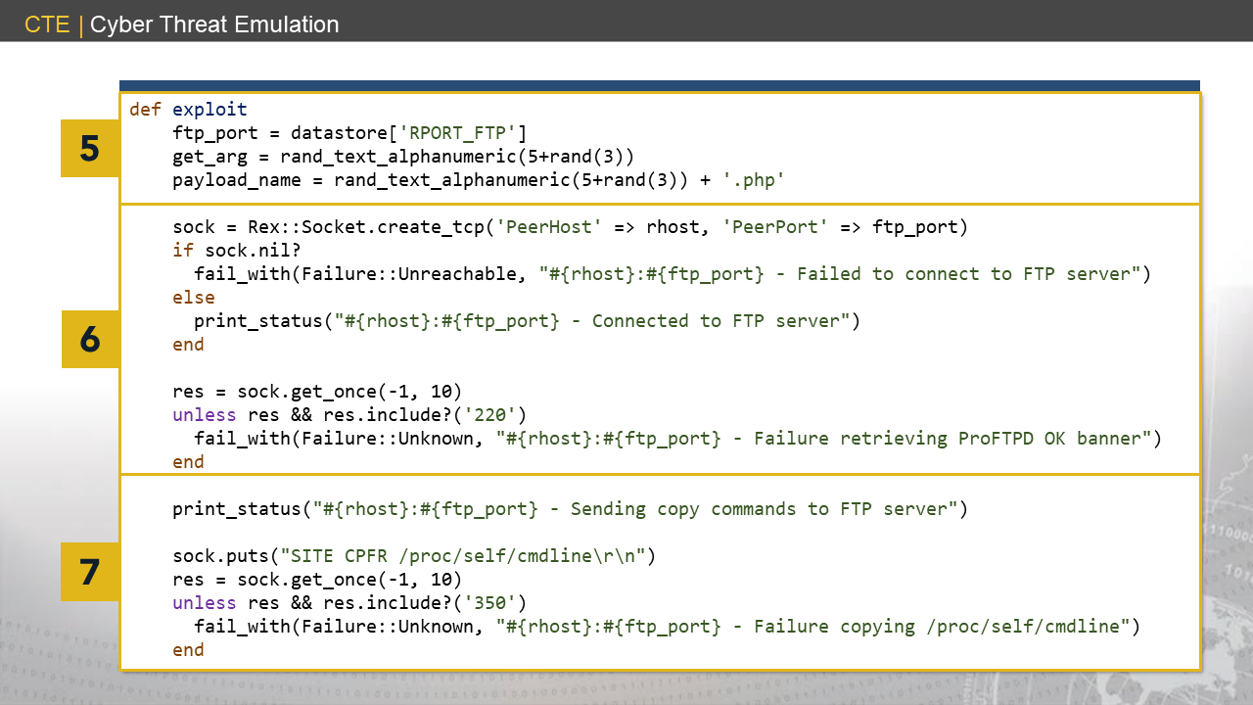
Notes:
searchsploit14

Slide 38
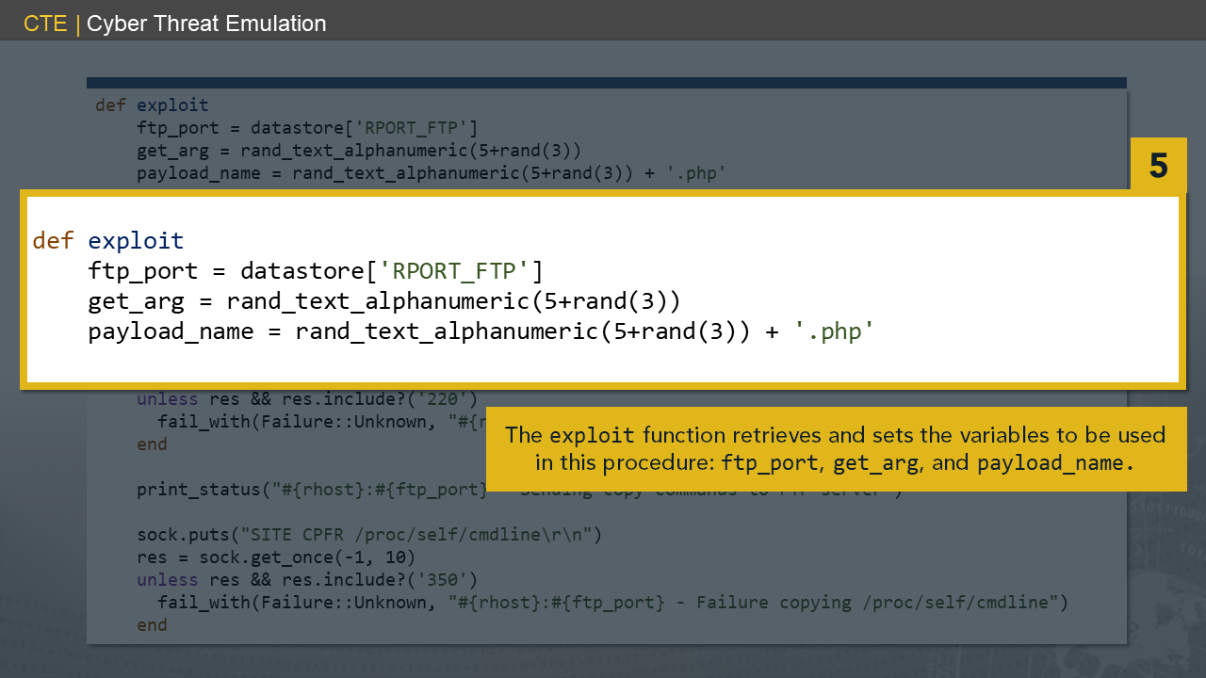
Notes:
searchsploit15

Slide 39
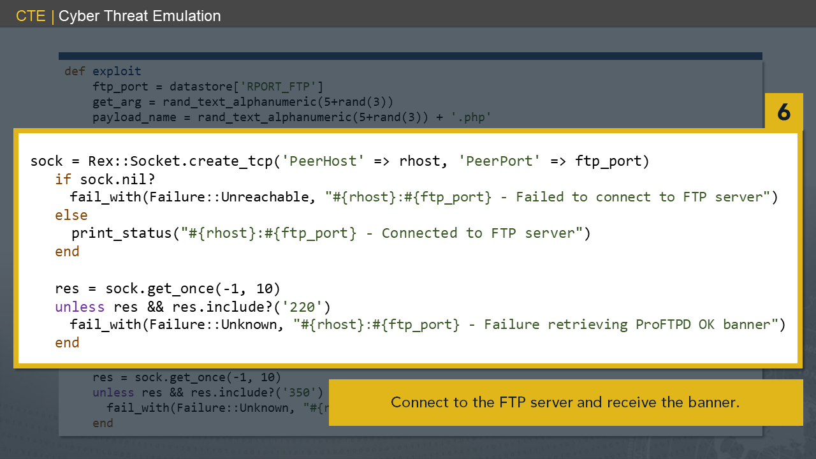
Notes:
searchsploit16

Slide 40
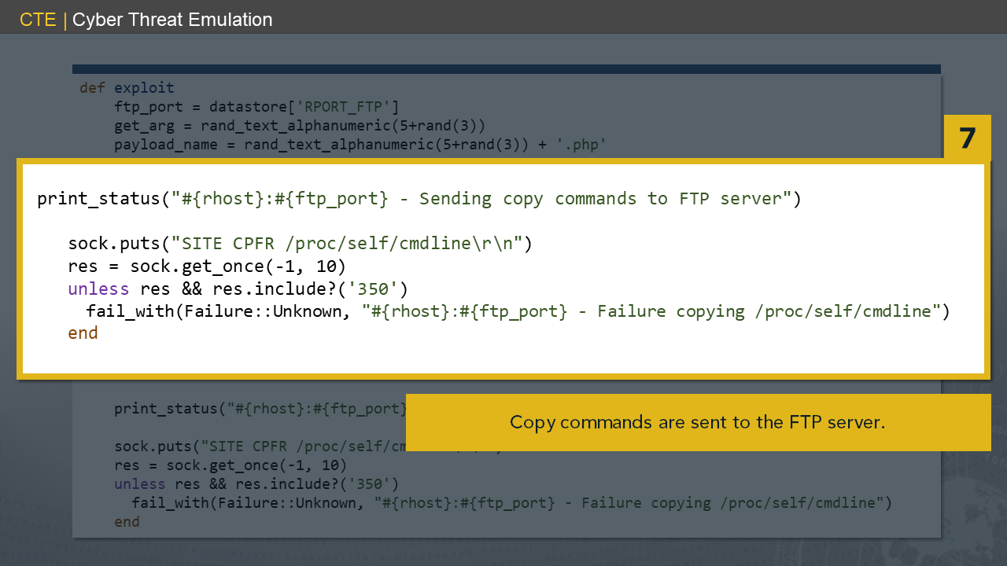
Notes:
searchsploit17

Slide 41
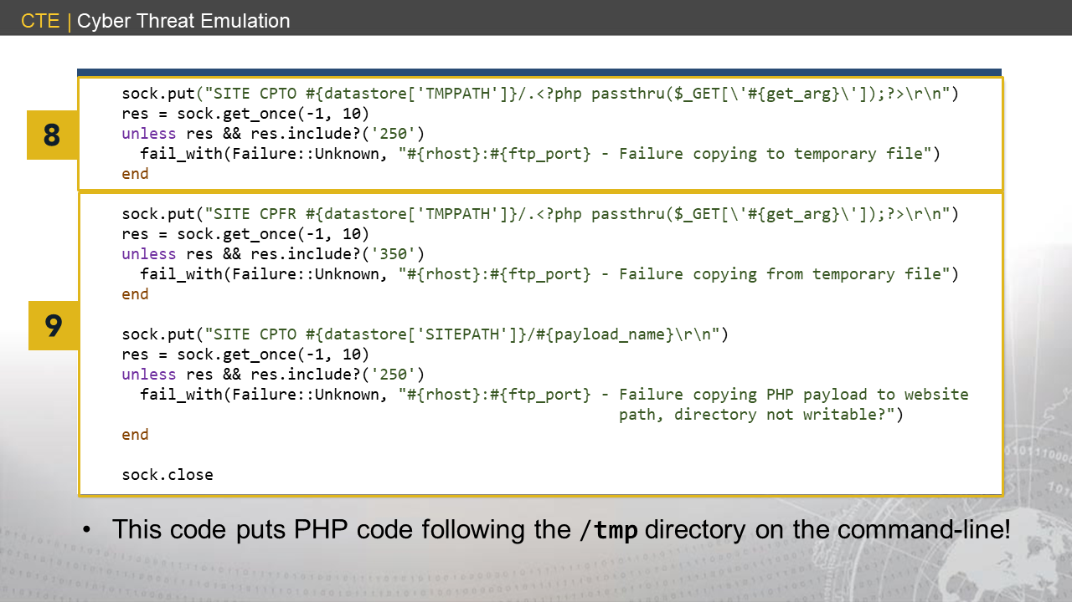
Notes:
searchsploit18

Slide 42
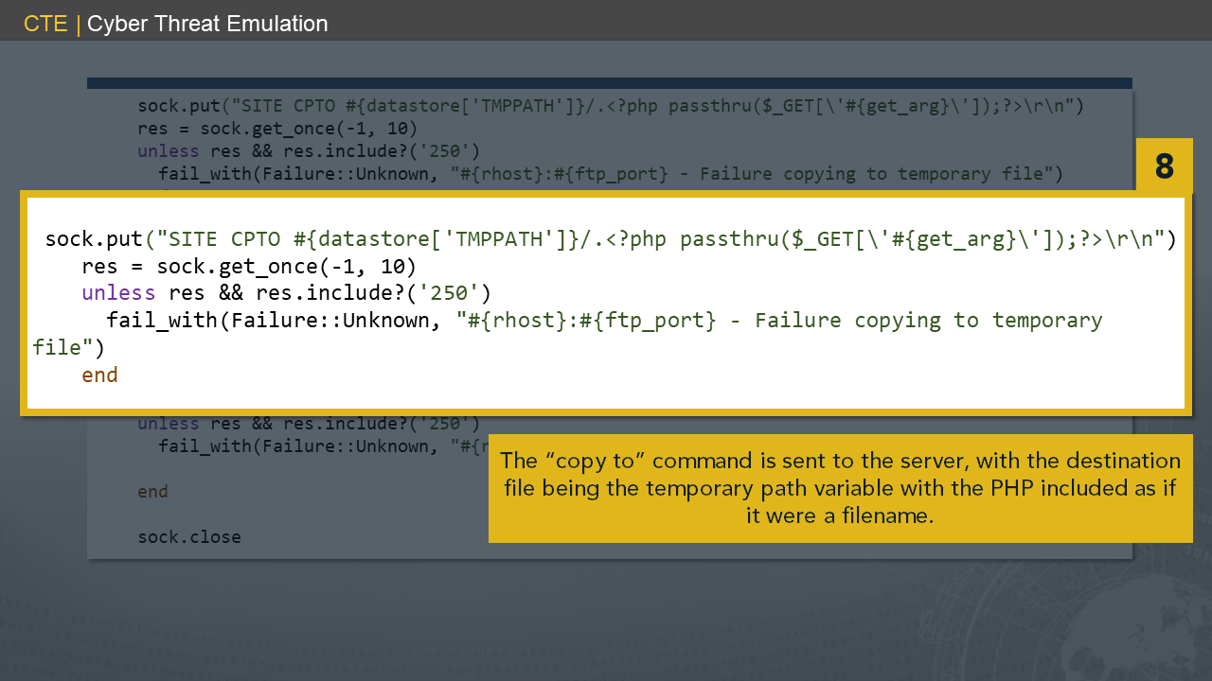
Notes:
searchsploit19

Slide 43
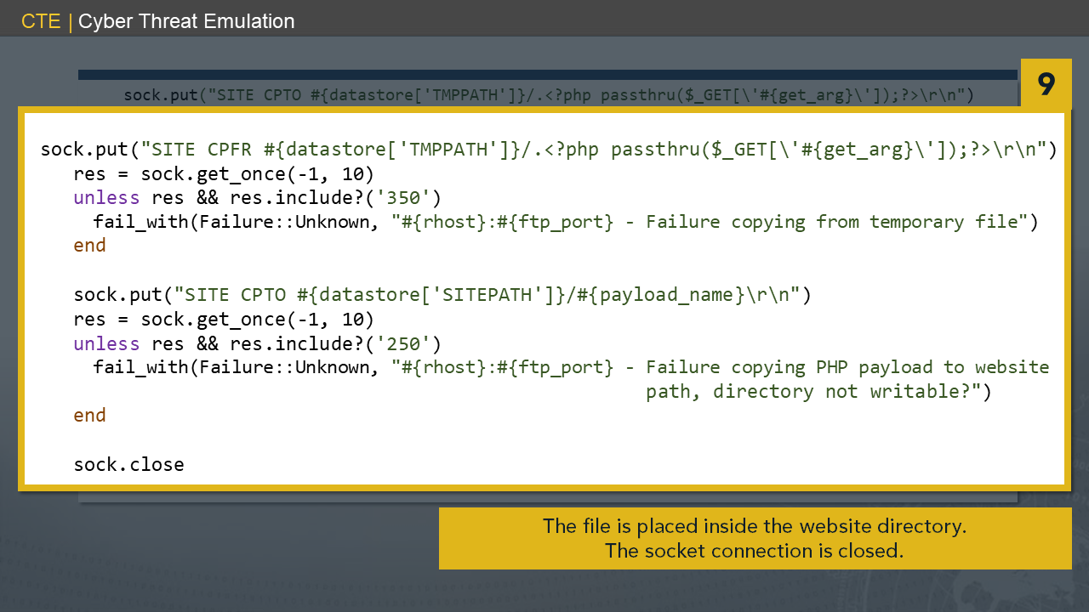
Notes:
searchsploit20

Slide 44
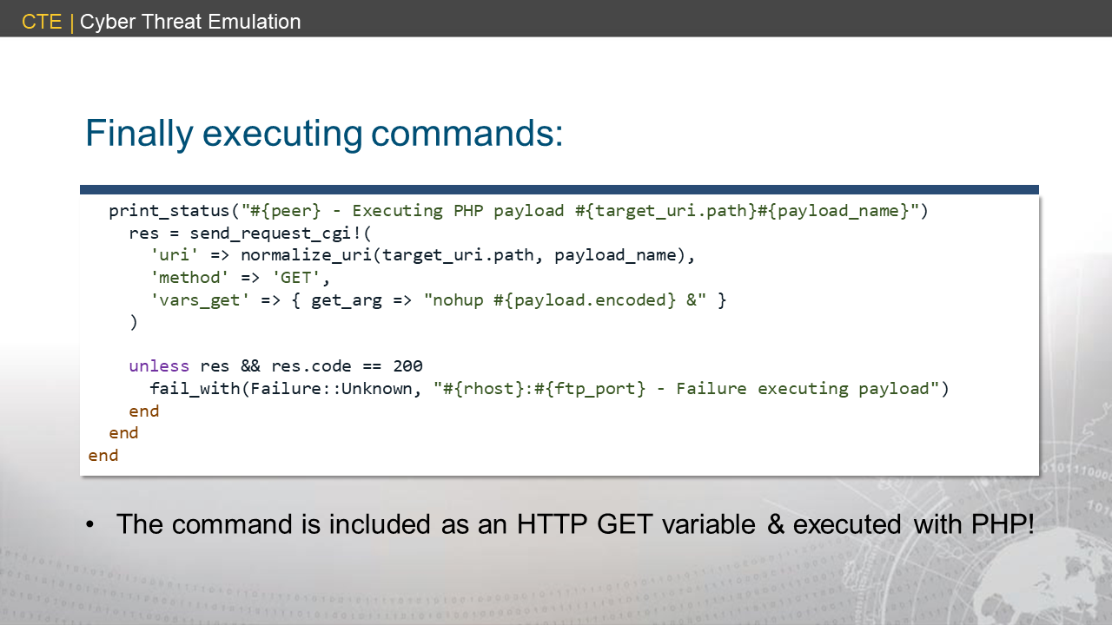
Notes:
searchsploit21

Slide 45
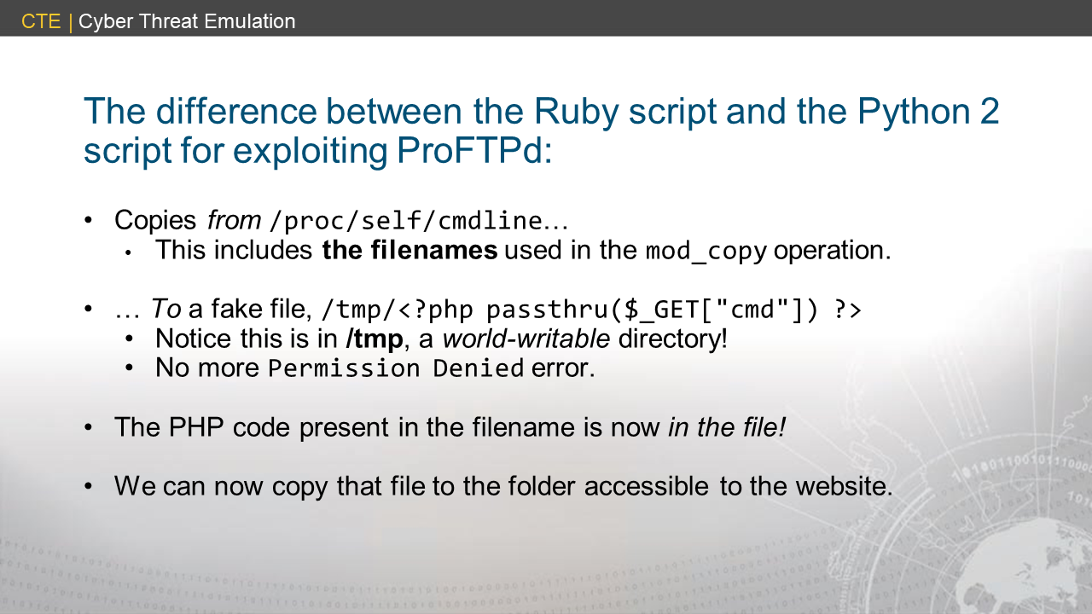

Slide 46
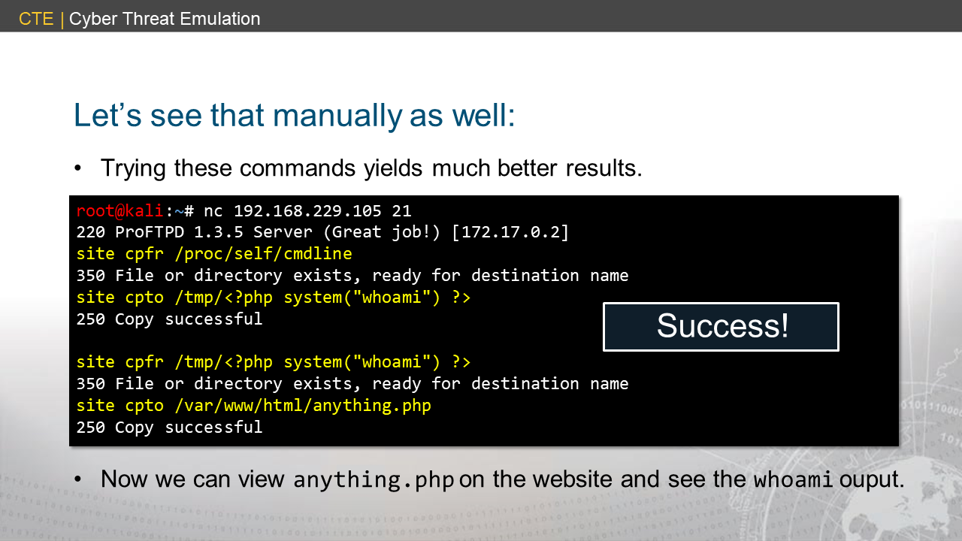
Notes:
<searchsploit22>

Slide 47
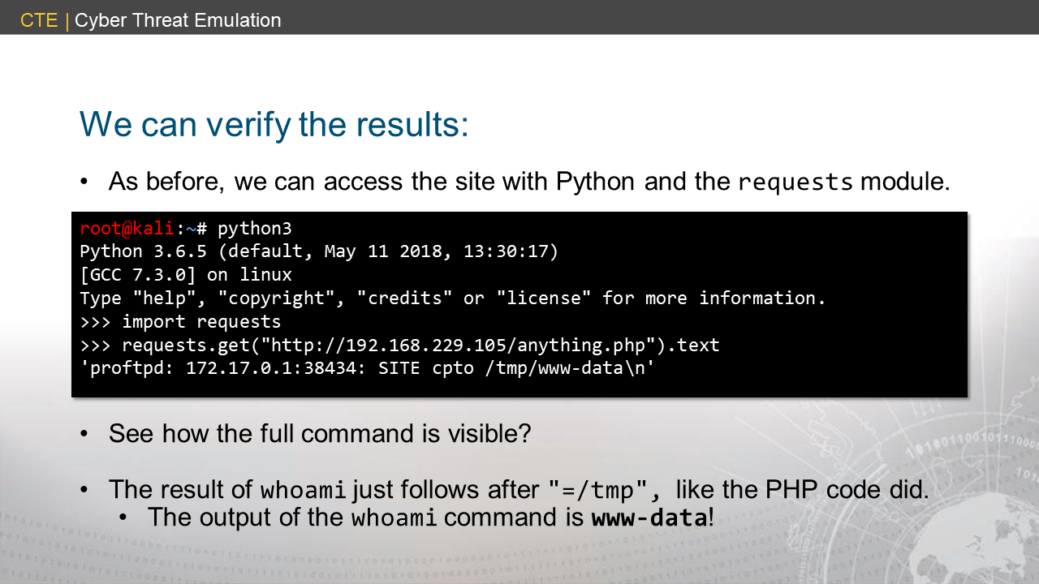
Notes:
<searchsploit23>

Slide 48
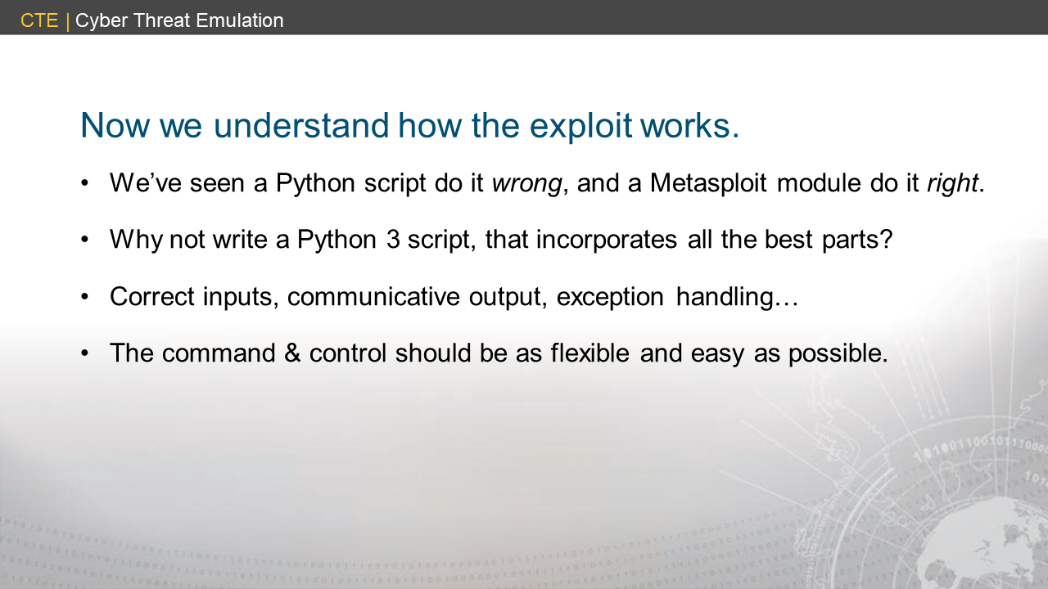

Slide 49
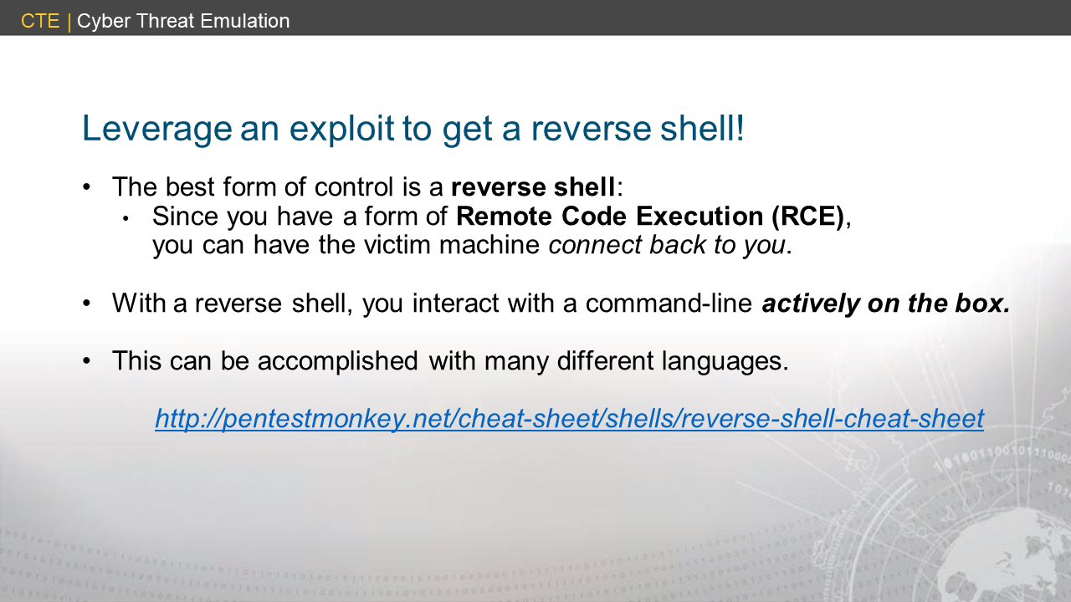

Slide 50
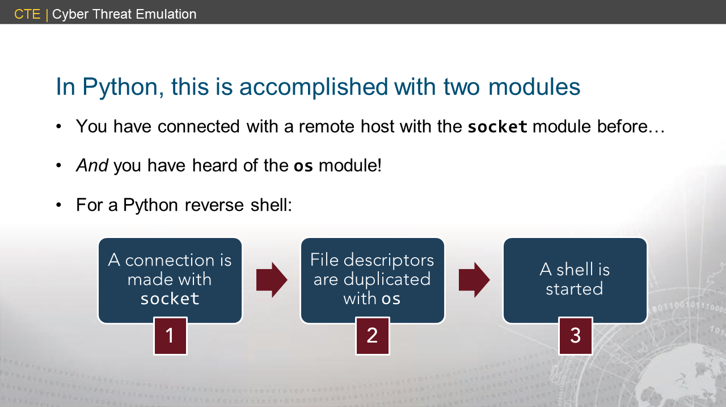
Notes:
<reverseshell1>

Slide 51


Slide 52


Slide 53


Slide 54

Notes:
<reverseshell4>

Slide 55

Notes:
<reverseshell5>

Slide 56


Slide 57

Notes:
<reverseshell6>

Slide 58

Notes:
<reverseshell7>

Slide 59


Slide 60


Slide 61


Slide 62


Slide 63


Slide 64


Slide 65


